Slide 1
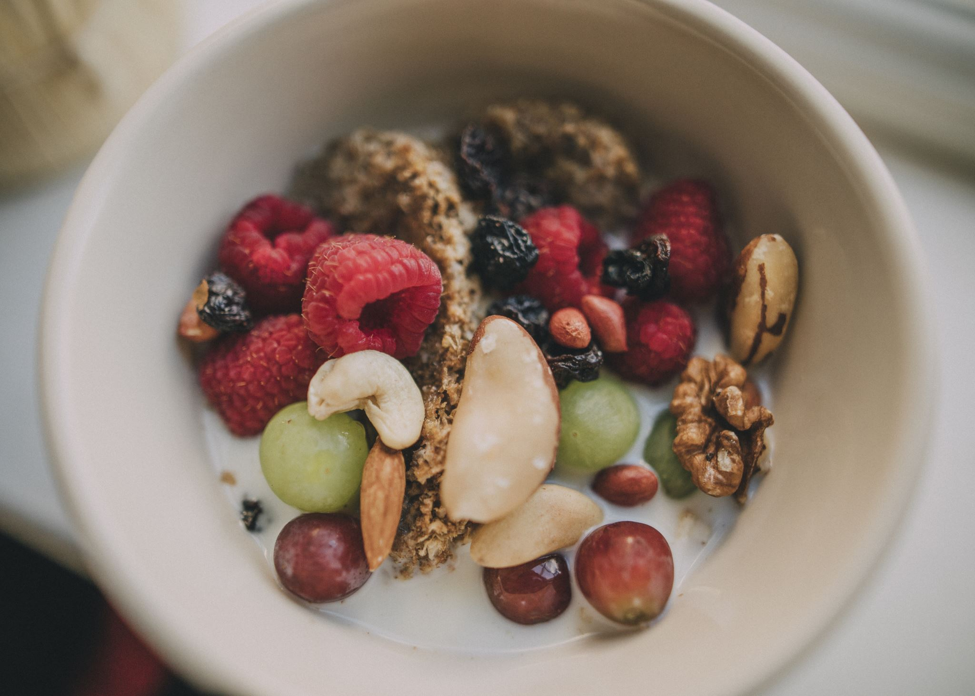
Fruit Classification

Slide 2
Contents
Homemade CNN Architecture
- The Flow
- Why it Failed?
State-of-the-art Architectures
- Workflow of Transfer Learning
Minutes for Environment Comparing

Slide 3
Homemade CNN Architecture The Flow
Config: Environment
Data Preprocessing
Modeling
Classification Report

Slide 4
Homemade CNN architecture Why it Failed?
What the failure is?
Training AUC and Accuracy are high.
Validation are high too.
But poor predictions.

Slide 5
Homemade CNN architecture Why it Failed?
Incorrect coding
Incorrect preprocessing
Keras or TensorFlow malfunction
Overfitting
Image augmentation
Dropout
Regularization
Simplify model
Early stopping
Validation set not representative enough

Slide 6
2. SOTA Architectures Workflow of Transfer Learning
Instantiate + load pre-trained weights
Freeze SOTA layers
Add custom layers
Train only the custom layers
Unfreeze SOTA layers
Train both SOTA + custom layers

Slide 7
Minutes for Environment Comparing
 | Conda – Docker PC | Google Colab | Cloud Platform
User-friendly | Hard | Easy
Speed | Fast | Killing slow
Multi-thread | Worse | Good
Failed your trust | Sometime | Always

